Slide 1
Lecture-10
Mathematics 2 (15B11MA211)
CO [C106.2]
Topic: Alternating Series, Absolute and Conditional Convergence
Reference for the lecture
R.K Jain and S.R.K. Iyenger, “Advanced Engineering Mathematics” fifth edition, Narosa publishing house, 2016.

Slide 2
Topics to be covered
Alternating Series
Solved Example
Absolute Convergence
Conditional Convergence
Solved Example

Slide 3
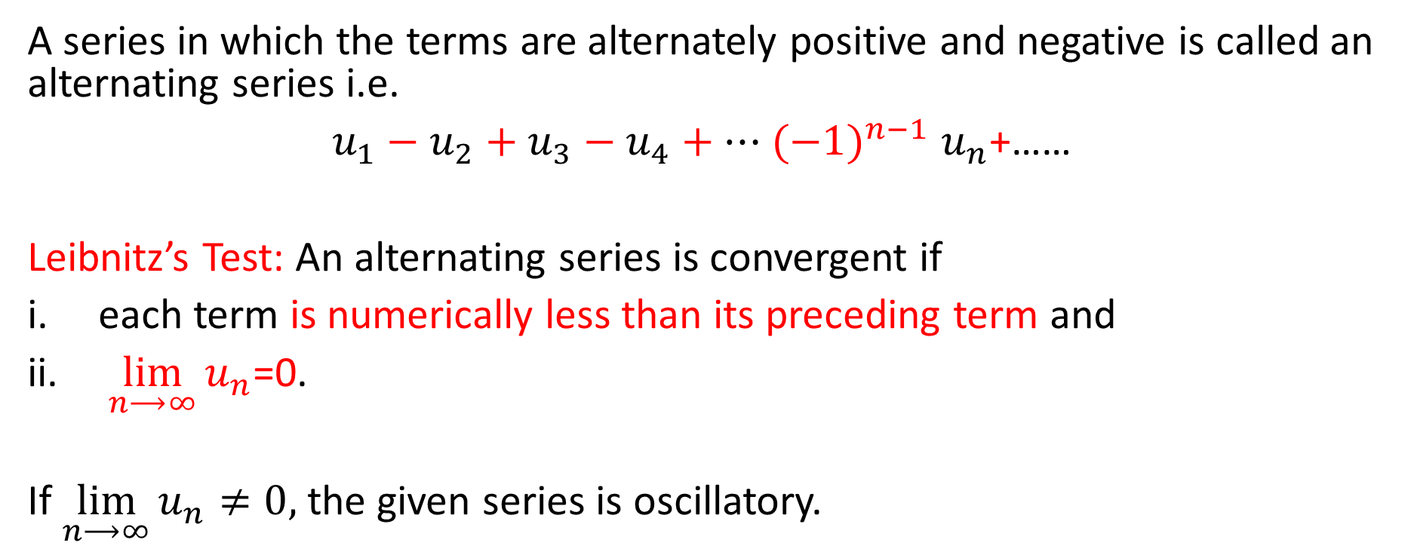
Alternating Series
A series in which the terms are alternately positive and negative is called an alternating series i.e.
$u_{1}−u_{2}+u_{3}−u_{4}+…$ ${(−1)}^{n−1}$ $u_{n}$+……
Leibnitz’s Test: An alternating series is convergent if
each term is numerically less than its preceding term and
$\lim_{n⟶∞}{u_{n}}$=0.
If $\lim_{n⟶∞}{u_{n}}≠0,$ the given series is oscillatory.

Slide 4
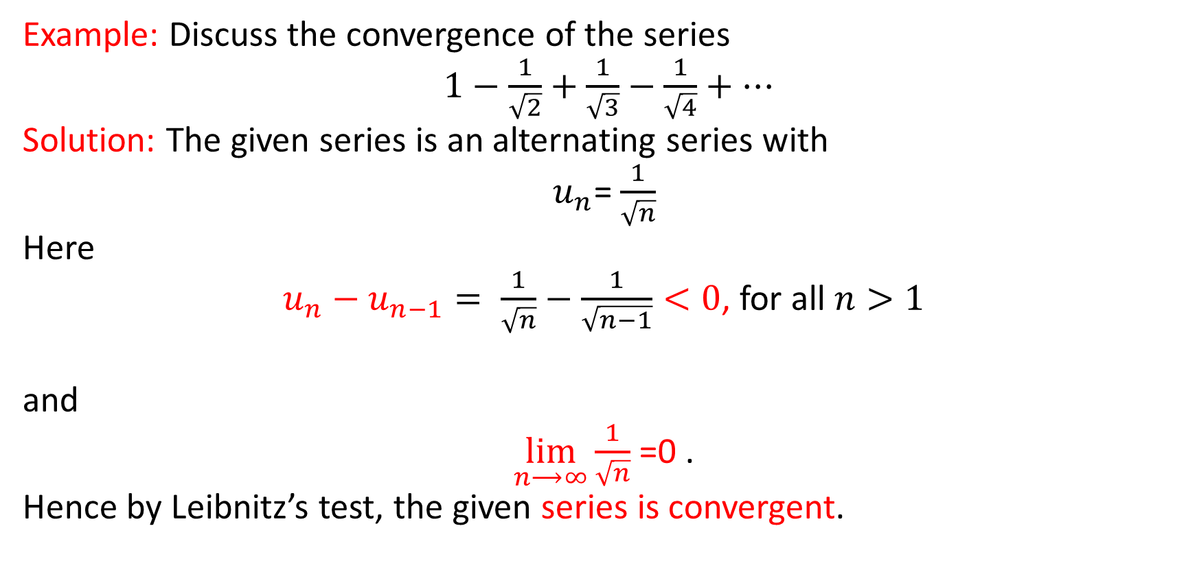
Example: Discuss the convergence of the series
$1−\frac{1}{\sqrt{2}}+\frac{1}{\sqrt{3}}−\frac{1}{\sqrt{4}}+…$
Solution: The given series is an alternating series with
$u_{n}$= $\frac{1}{\sqrt{n}}$
Here
$u_{n}−u_{n−1}= \frac{1}{\sqrt{n}}−\frac{1}{\sqrt{n−1}}<0$, for all $n>1$
and
$\lim_{n⟶∞}{\frac{1}{\sqrt{n}} }$=0 .
Hence by Leibnitz’s test, the given series is convergent.

Slide 5
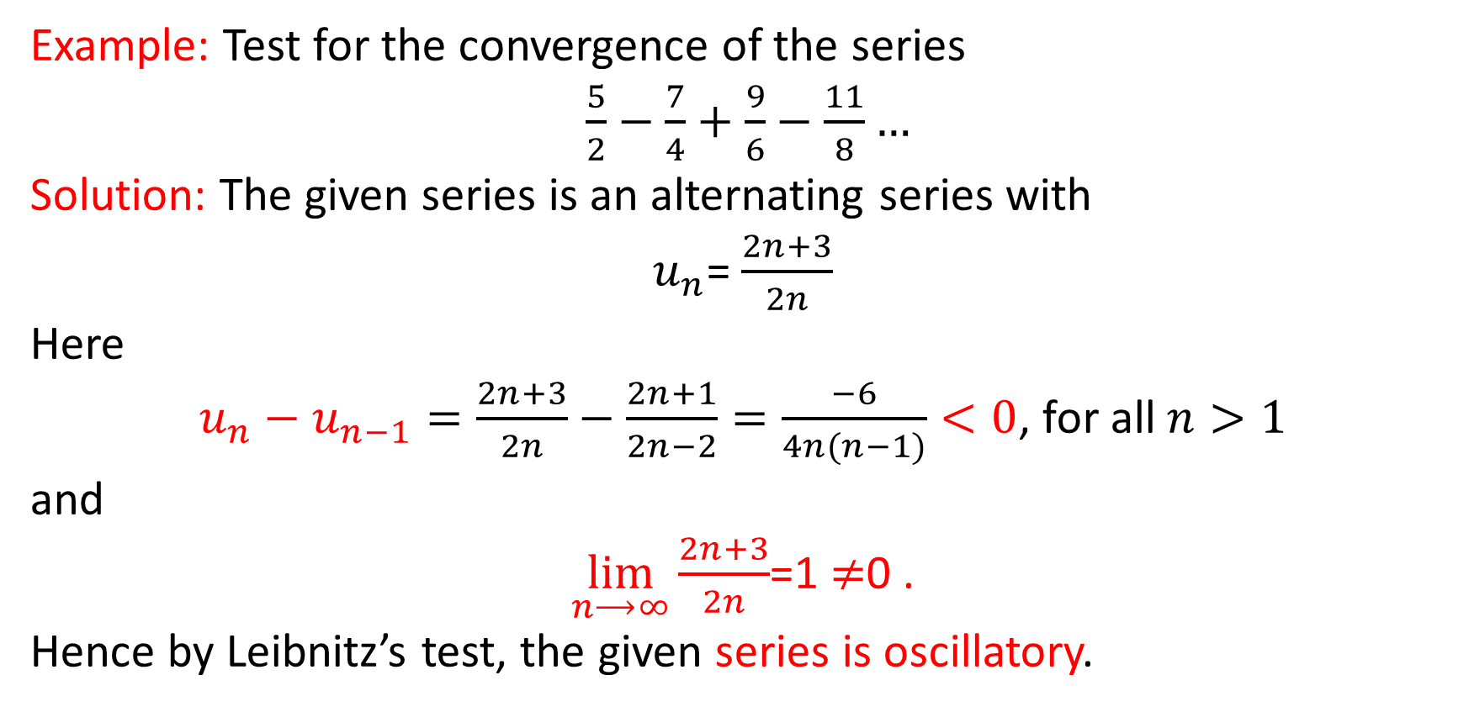
Example: Test for the convergence of the series
$\frac{5}{2}−\frac{7}{4}+\frac{9}{6}−\frac{11}{8}…$
Solution: The given series is an alternating series with
$u_{n}$= $\frac{2n+3}{2n}$
Here
$u_{n}−u_{n−1}=\frac{2n+3}{2n}−\frac{2n+1}{2n−2}=\frac{−6}{4n(n−1)}<0$, for all $n>1$
and
$\lim_{n⟶∞}{\frac{2n+3}{2n}}$=1 $≠$0 .
Hence by Leibnitz’s test, the given series is oscillatory.

Slide 6
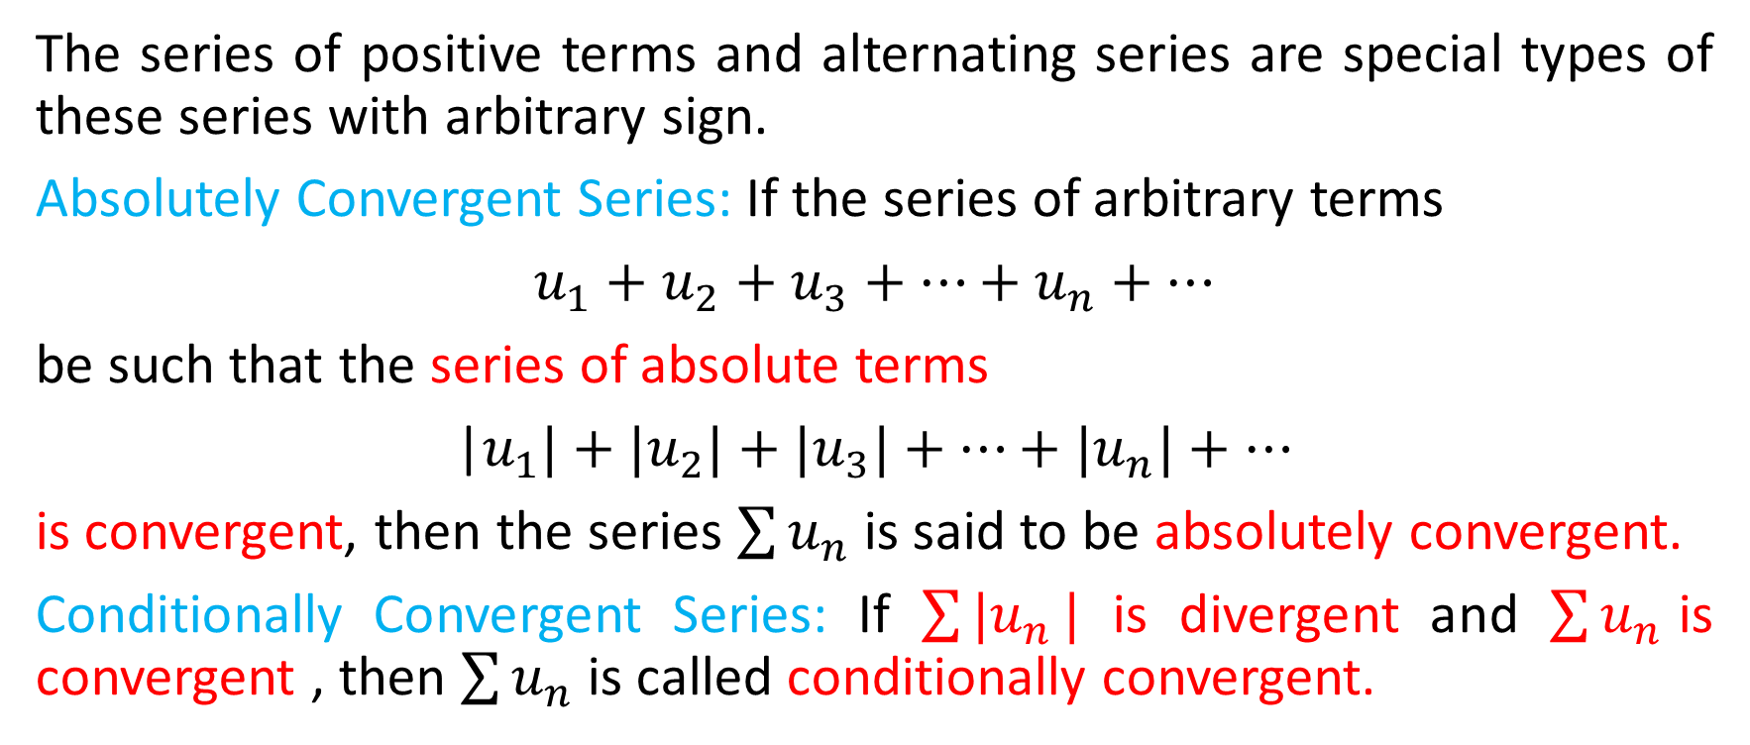
Series of Positive and Negative Terms
The series of positive terms and alternating series are special types of these series with arbitrary sign.
Absolutely Convergent Series: If the series of arbitrary terms
$u_{1}+u_{2}+u_{3}+…+$ $u_{n}+…$
be such that the series of absolute terms
|$u_{1}|+|u_{2}|+{|u}_{3}|+…+$ ${|u}_{n}|+…$
is convergent, then the series $\sum{u_{n}}$is said to be absolutely convergent.
Conditionally Convergent Series: If $\sum{{|u}_{n}}|$ is divergent and $\sum{u_{n}}$is convergent , then $\sum{u_{n}}$is called conditionally convergent.

Slide 7
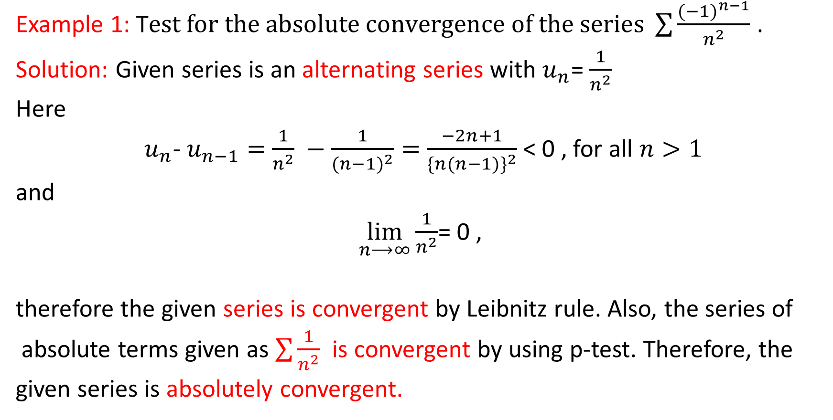
Example 1: T$est for the absolute convergence of the series \sum{\frac{{(−1)}^{n−1}}{n^{2}}}$ .
Solution: Given series is an alternating series with $u_{n}$= $\frac{1}{n^{2}}$
Here
$u_{n}$- $u_{n−1}=$ $\frac{1}{n^{2}} −\frac{1}{({n−1)}^{2}}=$ $\frac{−2n+1}{\{n({n−1)\}}^{2}}$< 0 , for all $n>1$
and
$\lim_{n⟶∞}{\frac{1}{n^{2}}}$= 0 ,
therefore the given series is convergent by Leibnitz rule. Also, the series of
absolute terms given as $\sum{\frac{1}{n^{2}}}$ is convergent by using p-test. Therefore, the
given series is absolutely convergent.

Slide 8
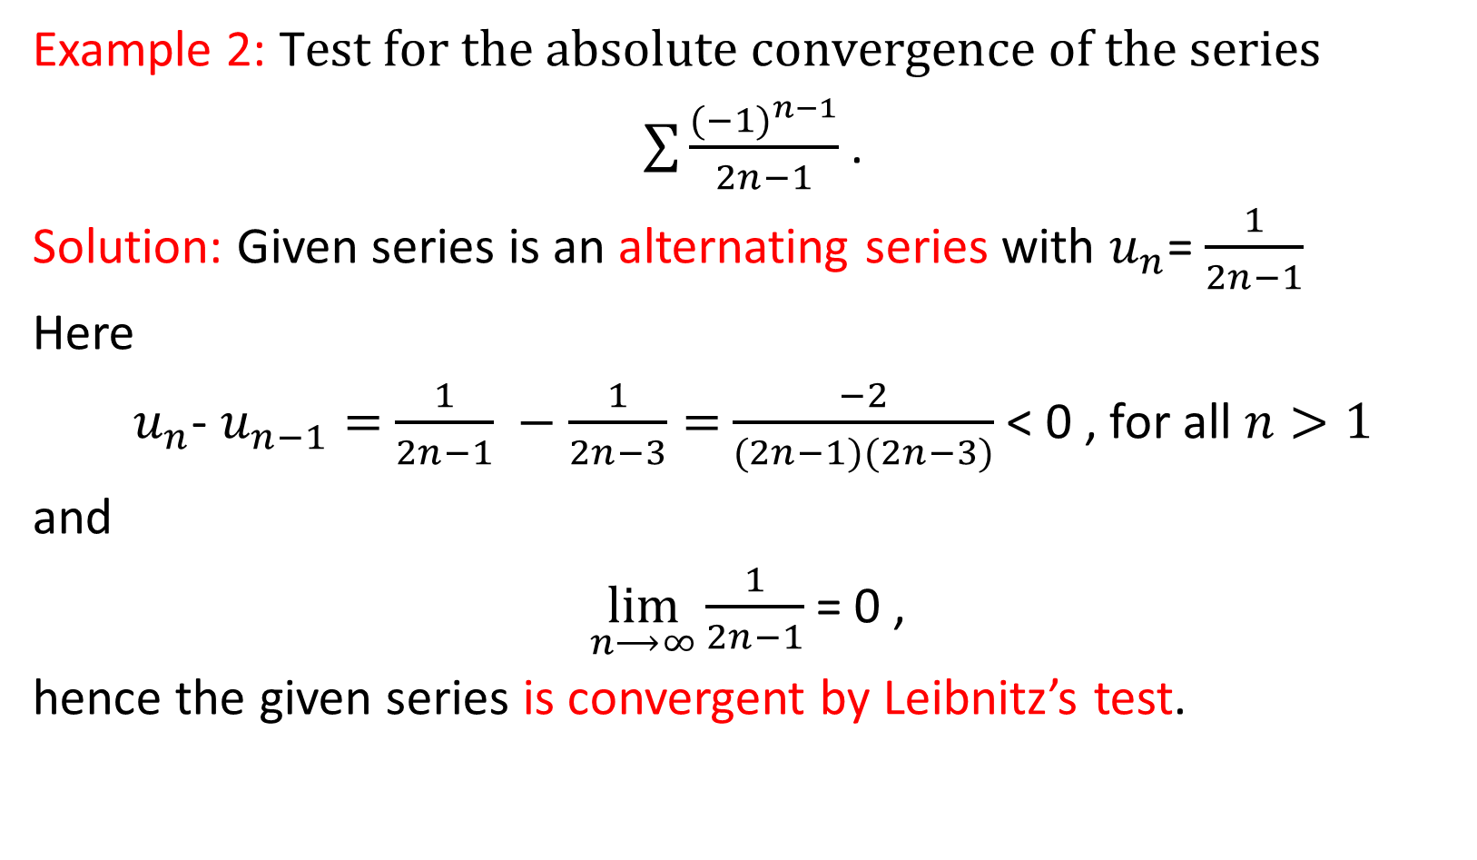
Example 2: T$est for the absolute convergence of the series$
$\sum{\frac{{(−1)}^{n−1}}{2n−1}}$ .
Solution: Given series is an alternating series with $u_{n}$= $\frac{1}{2n−1}$
Here
$u_{n}$- $u_{n−1}=$ $\frac{1}{2n−1} −\frac{1}{2n−3}=$ $\frac{−2}{(2n−1)(2n−3)}$< 0 , for all $n>1$
and
$\lim_{n⟶∞}{\frac{1}{2n−1} }$= 0 ,
hence the given series is convergent by Leibnitz’s test.

Slide 9
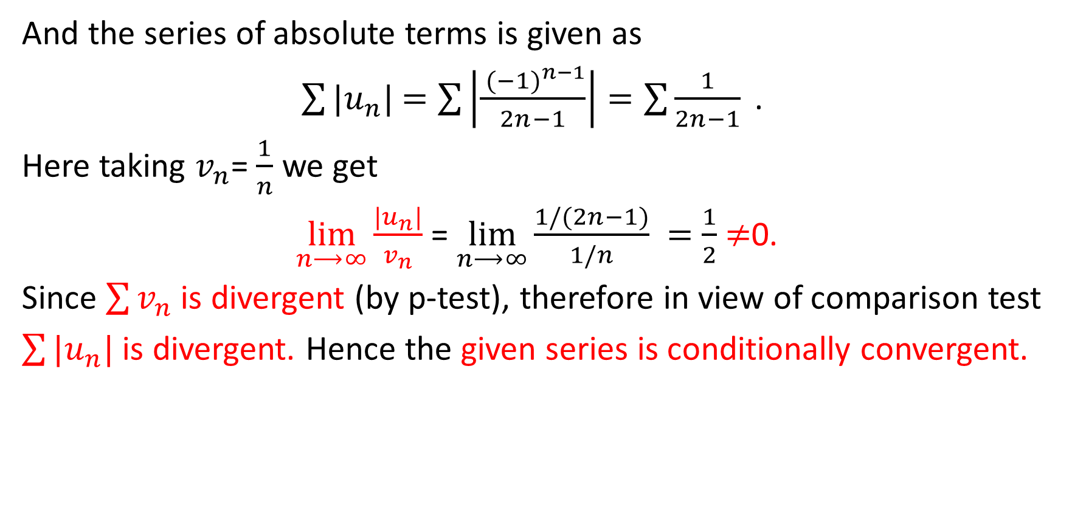
And the series of absolute terms is given as
$\sum{{|u}_{n}|}$ $=\sum{\left|\left.\frac{{ (−1)}^{n−1}}{2n−1}\right|\right.=\sum{\frac{1}{2n−1}}\text{ . }}$
Here taking $v_{n}$= $\frac{1}{n}$ we get
$\lim_{n⟶∞}{\frac{|u_{n}|}{v_{n}} }$= $\lim_{n⟶∞}{\frac{1/(2n−1)}{1/n} }=$ $\frac{1}{2}$ $≠$0.
Since $\sum{v_{n}}$ is divergent (by p-test), therefore in view of comparison test
$\sum{{|u}_{n}|}$ is divergent. Hence the given series is conditionally convergent.

Slide 10
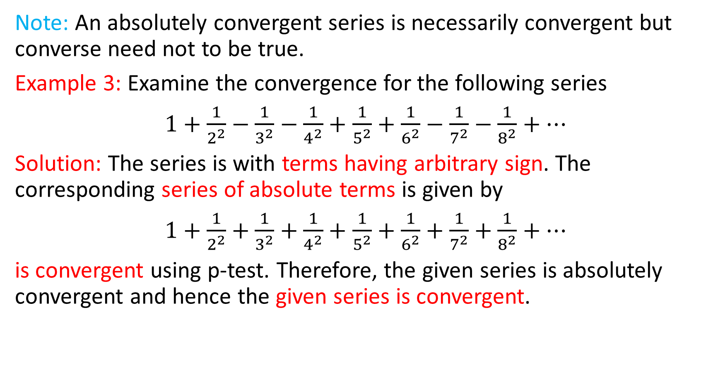
Note: An absolutely convergent series is necessarily convergent but converse need not to be true.
Example 3: Examine the convergence for the following series
$1+\frac{1}{2^{2}}−\frac{1}{3^{2}}−$ $\frac{1}{4^{2}}+$ $\frac{1}{5^{2}}+$ $\frac{1}{6^{2}}−\frac{1}{7^{2}}−\frac{1}{8^{2}}+…$
Solution: The series is with terms having arbitrary sign. The corresponding series of absolute terms is given by
$1+\frac{1}{2^{2}}+\frac{1}{3^{2}}+$ $\frac{1}{4^{2}}+$ $\frac{1}{5^{2}}+$ $\frac{1}{6^{2}}+\frac{1}{7^{2}}+\frac{1}{8^{2}}+…$
is convergent using p-test. Therefore, the given series is absolutely convergent and hence the given series is convergent.

Slide 11
Thank You

